Slide 1
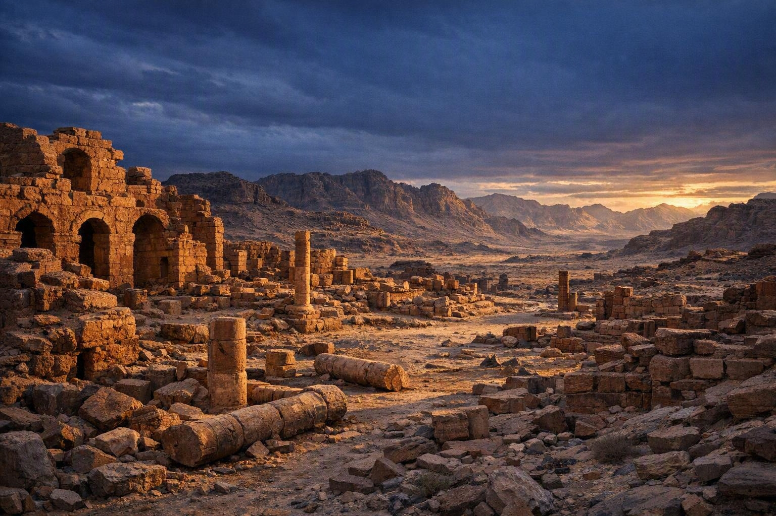
From Myth to Message
A SERMON • ISAIAH 34:14–16
Trusting God’s Word When Culture Gets Confused
Notes:
From Myth to Message: Trusting God's Word When Culture Gets Confused. Text: Isaiah 34:14-16. Introduction: Sometimes confusion begins with a simple misunderstanding. Isaiah 34:14 shows how a word can be pulled from Scripture into speculation. This lesson calls us to trust the authority of Scripture over the imagination of man.

Slide 2
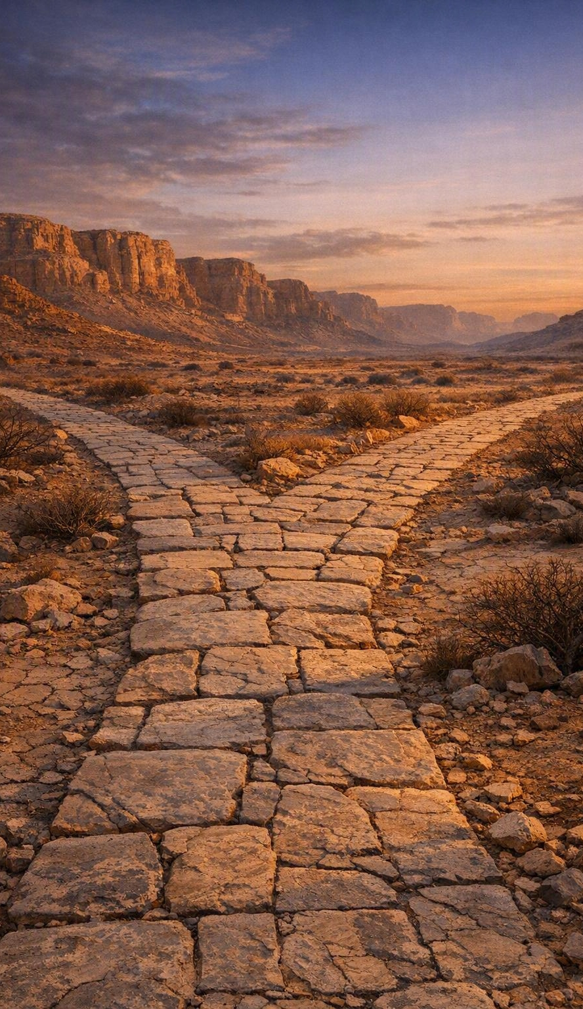
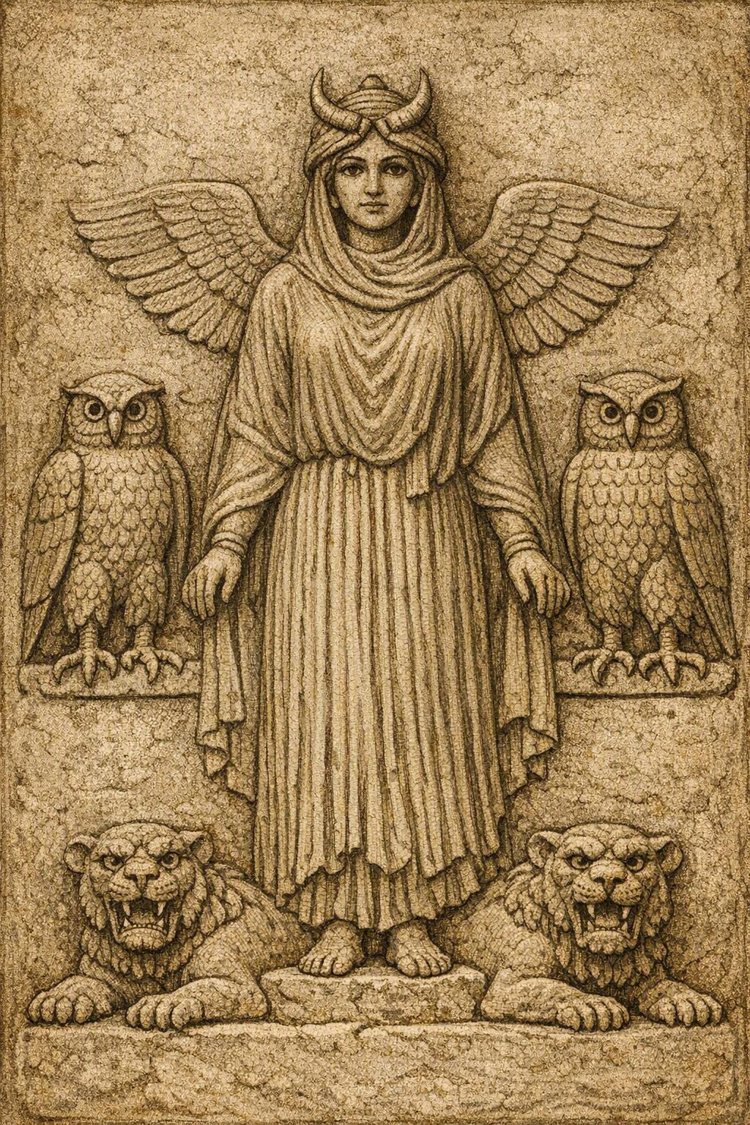
A Simple Misunderstanding
INTRODUCTION
Confusion begins quietly — a word repeated so confidently no one questions it. Isaiah 34:14 shows how one word can slip from Scripture into speculation.
The ancient relief later imagined as “Lilith.”
This lesson calls us to recognize, return, and respond.
Notes:
1. Confusion begins with a simple misunderstanding; people repeat things so confidently nobody questions them (GPS illustration: a man followed his GPS's 'turn left' into a strange church's parking lot and sat through Bible class before realizing he was due at the dentist). A wrong turn is funny; a wrong turn with the Word of God is tragic. 2. Isaiah 34:14 shows a word pulled from Scripture into speculation - the Hebrew term discussed as 'lilith' in the desolation of Edom; the Geneva Bible and KJV read it as an owl, later traditions made it a demonic/mythical figure. The issue: will we let God speak, or let culture rewrite what God has said? 3. The lesson: (A) recognize how easily culture influences interpretation, (B) return to the text and context of Scripture, (C) respond to the God who speaks with truth, judgment, mercy, and salvation.

Slide 3
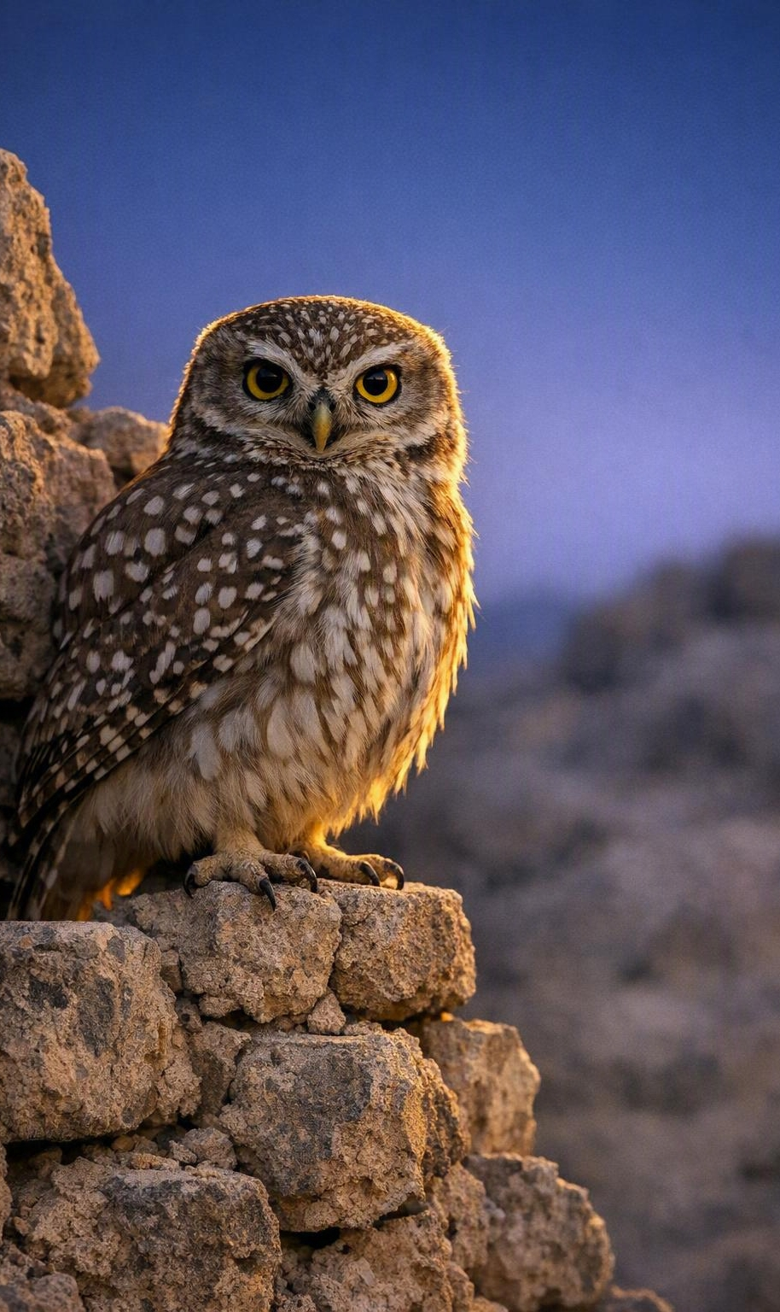
Culture Can Confuse What God Has Made Clear
POINT I
Edom lies in ruins — not a den of monsters, but proof that rebellion ends in desolation. Yet translators let culture creep in, turning a wilderness owl into myth.
Notes:
Point I: Culture Can Confuse What God Has Made Clear. A. Isaiah describes a real scene of judgment and desolation - Edom ruined, emptied, inhabited by wild creatures rather than proud rulers. The point is not fascination with monsters but that rebellion against God ends in desolation. B. Later translators imported the ideas of their culture; the Septuagint introduced mythical creatures where the Hebrew referred to animals of the wilderness - a wilderness owl became tangled with sirens, onocentaurs, lamias, and later legends. C. Illustration (whisper game): 'The owl is in the tree' becomes 'The monster is in the sanctuary.' Every careless repetition moves the message farther from the truth. When men repeat culture more than Scripture, confusion grows stronger than conviction.

Slide 4
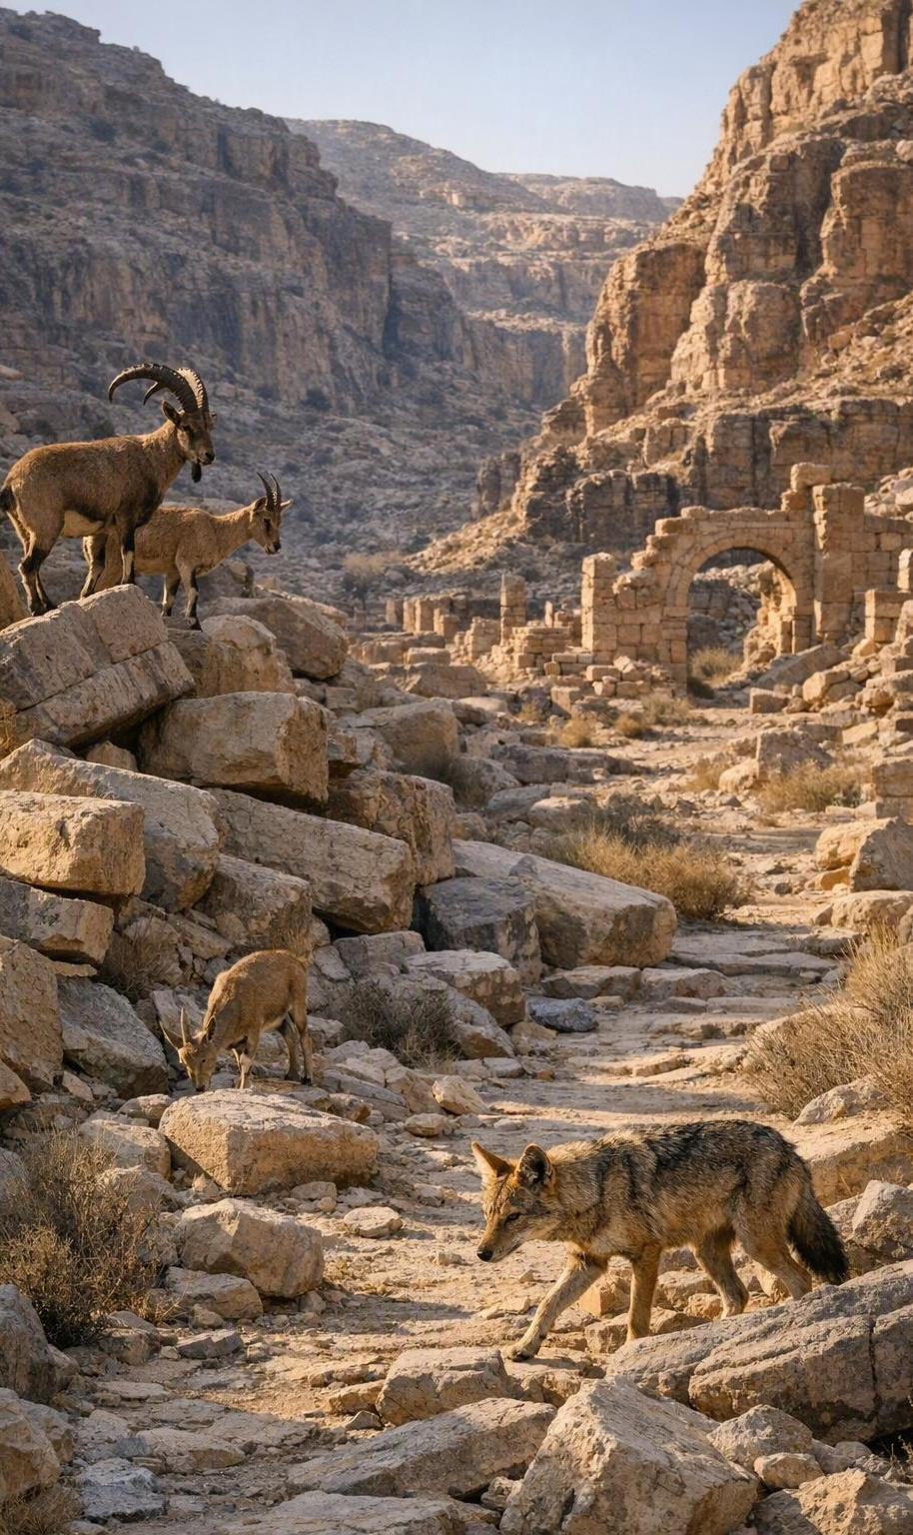
Context Protects Us from Careless Conclusions
POINT II
Isaiah names ordinary creatures of desolation — jackals, goats, ravens, owls. In context, it is only the wild returning where pride once stood.
Notes:
Point II: Context Protects Us from Careless Conclusions. A. Isaiah 34 surrounds the debated word with ordinary creatures of desolation - jackals, goats, owls, ravens, and birds of prey fit the prophet's picture of an abandoned land. A passage about judgment needs no mythology; the truth is serious enough. B. Read in harmony with its setting, the image is the wild returning where human pride once stood; God's judgment strips away the illusion of permanence. C. Illustration (puzzle piece): hold one blue piece and you may call it water, sky, glass, or cloth. Put it in the full picture, and the guesswork ends.

Slide 5
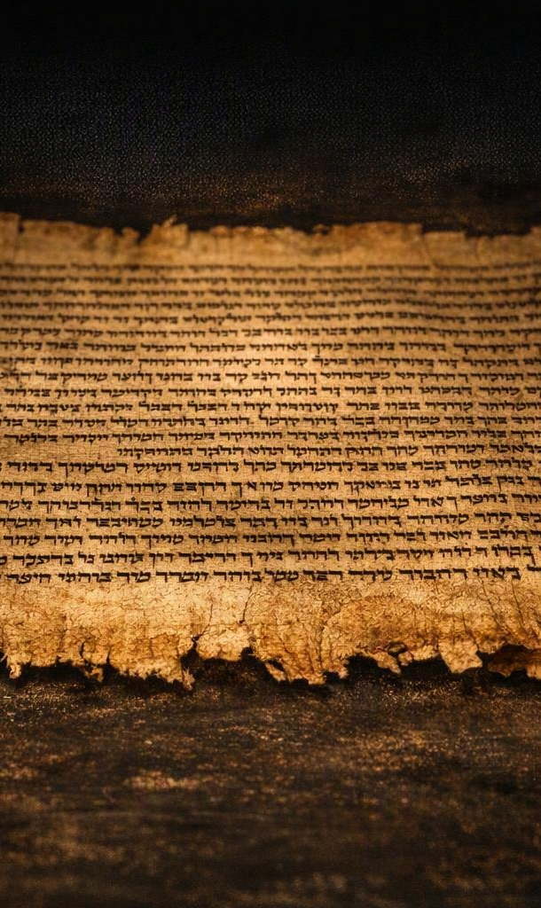
God’s Word Stands Above Human Imagination
POINT III
Isaiah builds no doctrine on legends; he calls us to hear the LORD.
“Seek out of the book of the LORD, and read.” — Isaiah 34:16
Notes:
Point III: God's Word Stands Above Human Imagination. A. Isaiah does not build doctrine on legends; he calls us to hear the word of the Lord - Isaiah 34:16, 'Seek out of the book of the LORD, and read.' B. The Scriptures are not weakened because men misunderstand them. A misread map does not prove the road is wrong; a misused Bible does not prove the Bible is unreliable - it proves we must handle it carefully. C. Illustration: a child drew his father with arms as long as tree branches; the picture was not accurate, but it did not change who the father really was. Human imagination may distort the picture, but it cannot change the truth of God's Word.

Slide 6
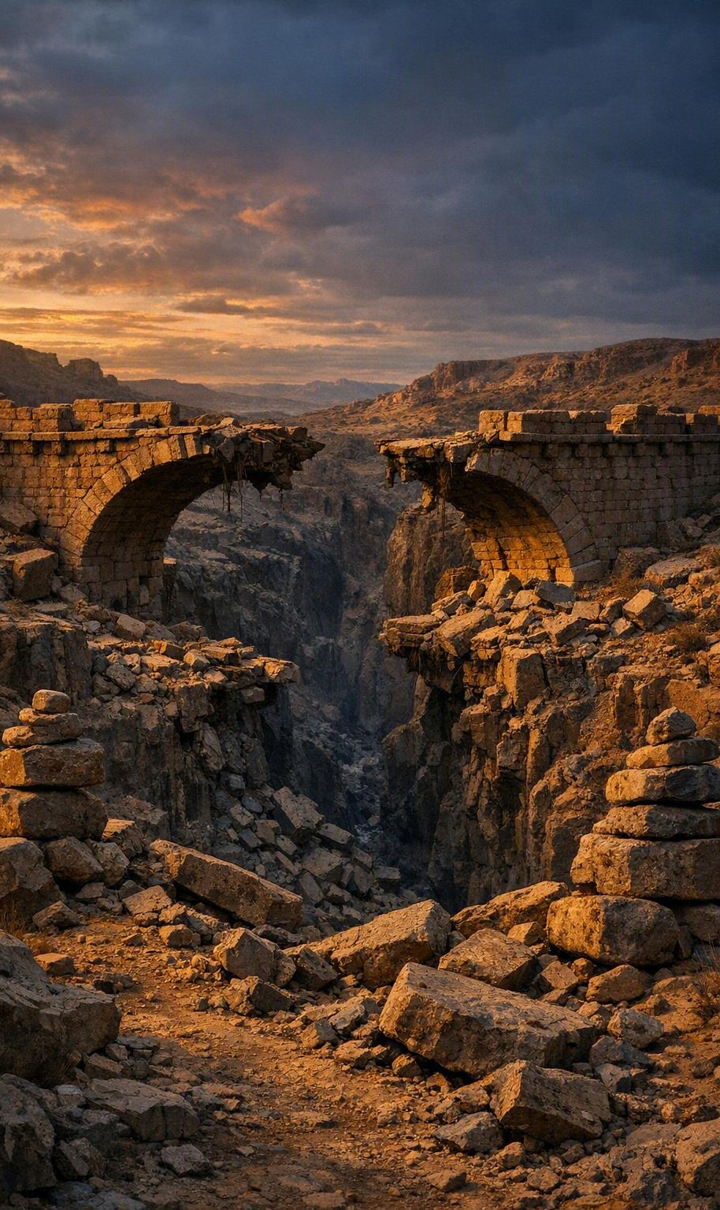
The Same Word That Warns Also Invites
POINT IV
Edom’s ruin warns that no one stands safely against God — pride builds cities; sin empties them. Yet the same Word points to Christ.
Notes:
Point IV: The Same Word That Warns Also Invites. A. Isaiah 34 warns that sin brings judgment; Edom's ruin reminds us no people, nation, or person can stand safely against God - pride builds cities; sin empties them. B. The fuller message of Scripture points us to Christ - the Lord who judges sin also sent His Son to save sinners. The gospel is not mythology, superstition, or human invention; it is the death, burial, and resurrection of Jesus Christ. C. Illustration: a warning sign beside a collapsed bridge is not cruelty; it is mercy. God's warnings are not given to embarrass us but to rescue us. The question is whether we will stop before it is too late.

Slide 7
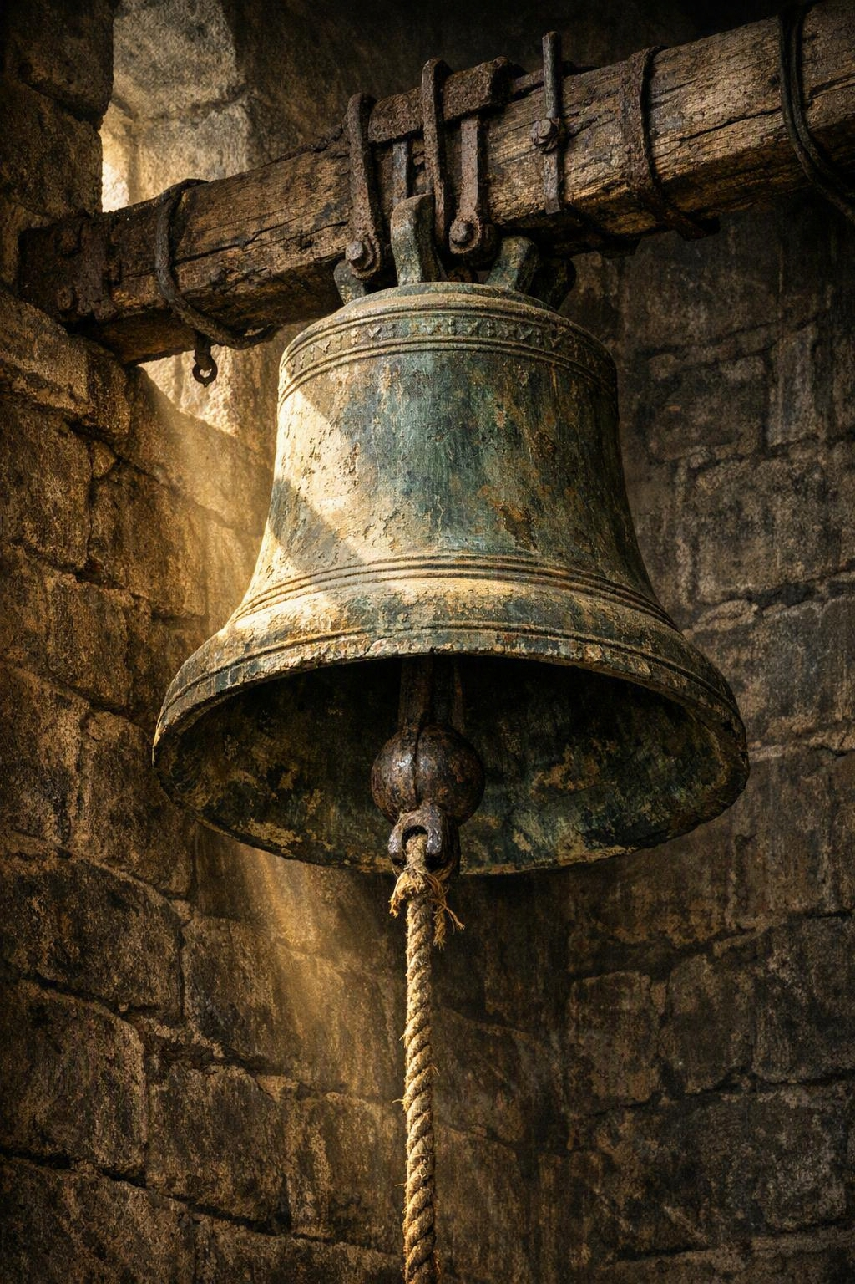
What Will You Do with the Word of God?
CONCLUSION
THE DRIFT
SOLID GROUND
An owl became a monster.
Context became speculation.
Warning became curiosity.
Context matters.
Truth matters.
Obedience matters.
Not only “What does this word mean?”
but “What will I do with the Word of God?”
Will we hear the bell?
Notes:
Conclusion. 1. Confusion grows when culture takes control: men turned an owl into a monster, context into speculation, God's warning into a curiosity. 2. Scripture brings us back to solid ground: context matters, truth matters, obedience matters. 3. The final question is not only 'What does this word mean?' but 'What will I do with the Word of God?' Illustration: imagine a town that argued for years about the design of a warning bell - too old, too plain, the sound too sharp. Then one night the fire came, and the only question that mattered was whether anyone would hear the bell and leave the burning house.

Slide 8
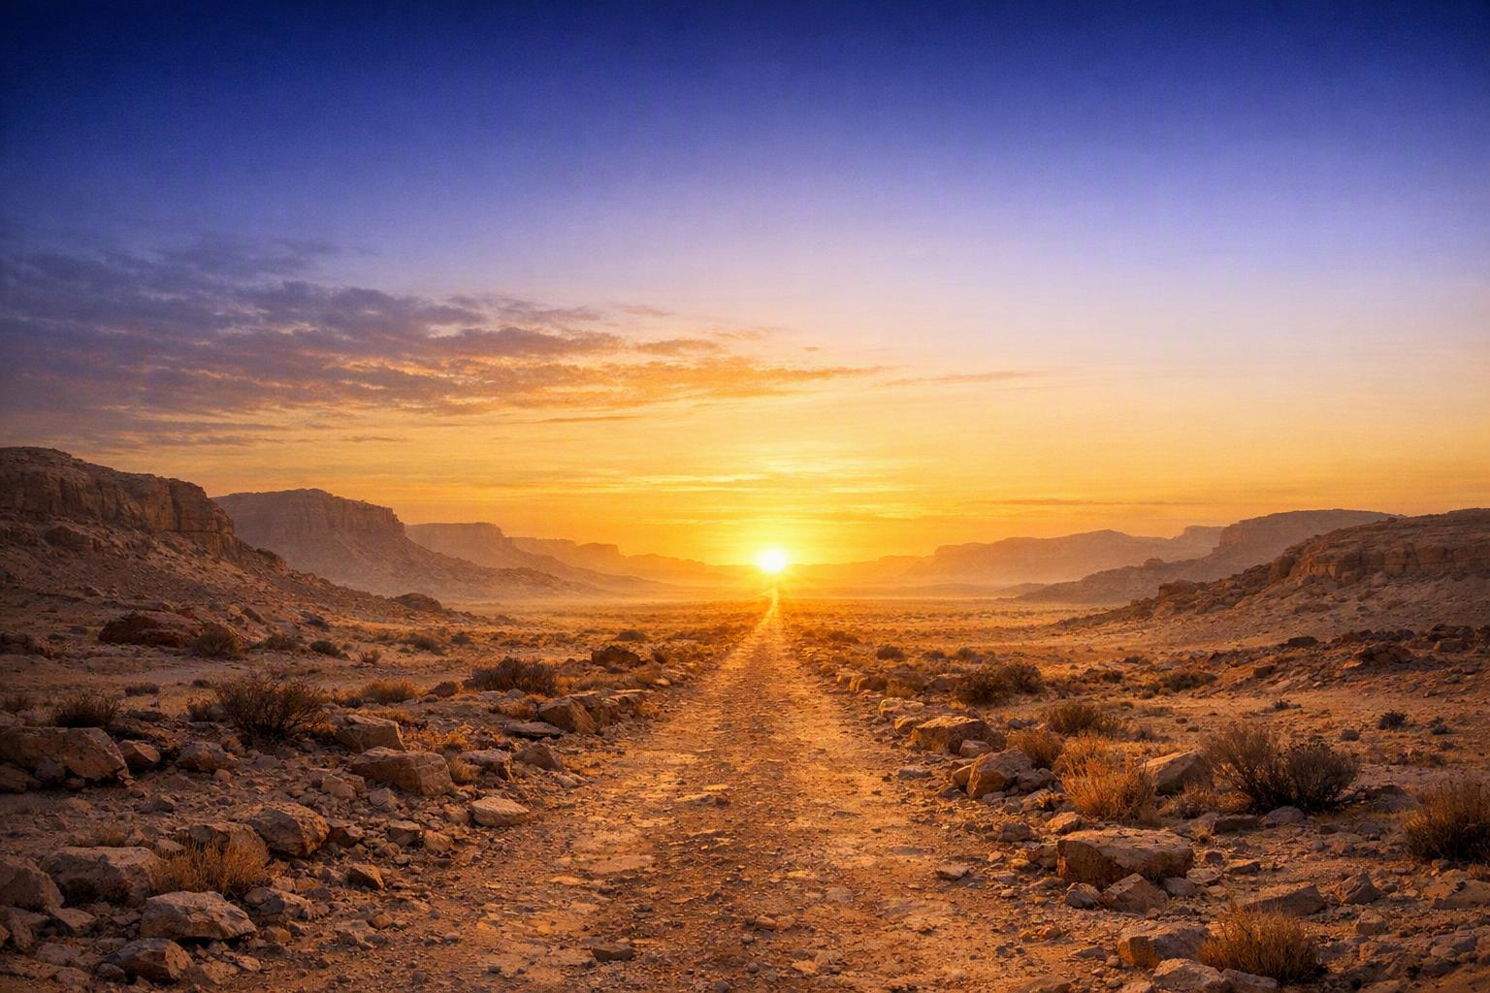
Come While We Stand and Sing
INVITATION
God’s Word is not merely to be studied; it is to be obeyed.
IF YOU ARE OUTSIDE OF CHRIST
Hear, believe that Jesus is the Son of God, repent, confess Him, and be baptized for the remission of sins.
IF YOU HAVE WANDERED
Repent, confess your sin, and return to faithful service.
The way is open. Christ is ready to save.
Notes:
Invitation. God's Word is not merely to be studied; it is to be obeyed. If you are outside of Christ, the gospel calls you to hear the Word of God, believe that Jesus Christ is the Son of God, repent of your sins, confess Christ before men, and be baptized into Christ for the remission of sins. If you are a child of God who has wandered, the same Lord calls you to repent, confess your sin, and return to faithful service. Do not stand in a burning house debating the bell. Do not let culture, confusion, pride, or delay keep you from the Savior. The Word has sounded. The way is open. Christ is ready to save. Come while we stand and while we sing.

